Slide 1

Pandas with
Time Series

Slide 2
Python for Finance
Now that we have an understanding of how to work with pandas for general data let’s go over a few key points of working with time series data with pandas!

Slide 3
Python for Finance
The majority of our data will be in the form of a time series, with a DateTime index and some corresponding value.
We will learn how to use pandas’ special time series features to work with this sort of data.

Slide 4
Python for Finance
This section will cover the following:
  DateTime Index
  Time Resampling
  Time Shifts
  Rolling and Expanding

Slide 5
Let’s get started!

Slide 6
DateTime Index

Slide 7
Python for Finance
Often the time and date information won’t just be in a separate column, but instead be the actual index!
Let’s discover the built in pandas tools for creating and working with a DateTime Index.

Slide 8
Time Resampling

Slide 9
Python for Finance
We will usually get data that has a DateTime Index on a smaller time scale (every day, every hour, etc…)
However, it is often a good idea to aggregate the data based off some frequency (monthly, quarterly, etc…)

Slide 10
Python for Finance
While using groupby could solve part of this issue, a simple groupby isn’t “smart” enough to understand things like business quarters or business year starts.
Luckily, pandas has frequency sampling tools to help with this!

Slide 11
Python for Finance
To learn about this, we will use a stock market data set of Walmart prices.
Its located under the time_data folder under the 5-Pandas-with-Time-Series folder.
Let’s get started!

Slide 12
Time Shifting

Slide 13
Python for Finance
Certain models will require us to shift our data forward or backward a certain amount of time steps.
Luckily pandas makes this very easy, let’s find out how!

Slide 14
Rolling and Expanding

Slide 15
Python for Finance
We can use pandas’ built-in rolling methods to create things like a rolling mean based off a given time period.
Let’s quickly discuss what a rolling method can be used for.

Slide 16
Python for Finance
Often daily financial data can be a bit noisy.
We can use the rolling mean (often called Moving Average) to get more signal about the general trend of the data.

Slide 17
Python for Finance
You will provide a window of a set time period and then use that to calculate your aggregate statistic (such as the mean).
Let’s see what this looks like with pandas in our jupyter notebook!

Slide 18
Bollinger Bands

Slide 19
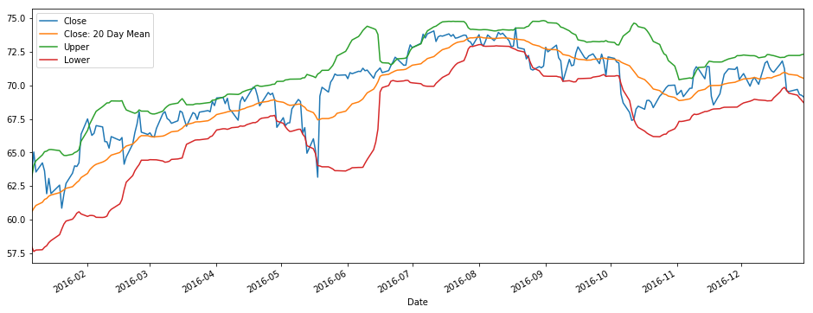
Python for Finance

